Slide 1


Impact of COVID-19 on the U.S. Housing Market
Marissa Tan

Slide 2

Introduction
The United States has experience the steady growth in the housing market. This steady growth was interrupted by COVID-19 pandemic. This study compares the United States’ housing market before and after COVID -19.
This information is important to the local government and real estate developers when planning to develop the next community.

Slide 3

Research Questions
Has there been a change in house prices since COVID-19?
Has there been a change in in-demand house location since COVID-19?
Has there been a change in buyer’s house buying criteria since COVID-19?

Slide 4
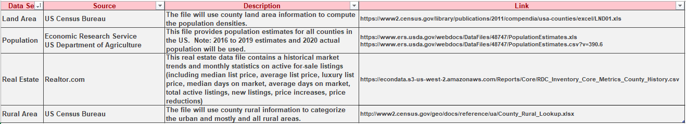
Data Sources

Slide 5
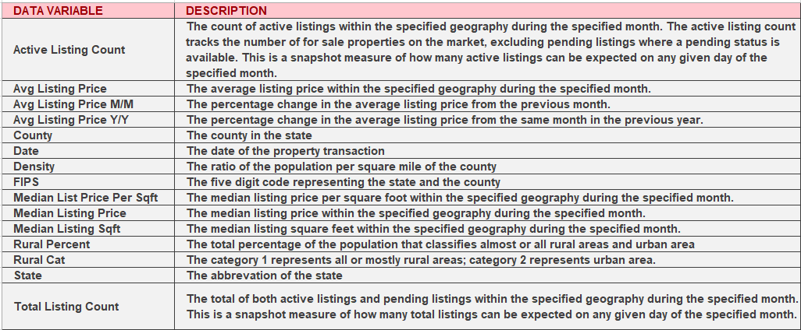
Data Variables

Slide 6

Variables and Measurements
Average listing price and average listing prices changes per year for the state, individual state, and county will be to analyzed during 2019 and 2021.
The basis of comparison is pre-COVID (2019) and post-COVID (2021)
The unit for analysis used is FIPS which represents the Federal Information Processing Standard code. FIPS is a five digit code that uniquely identifies counties in the United States.

Slide 7
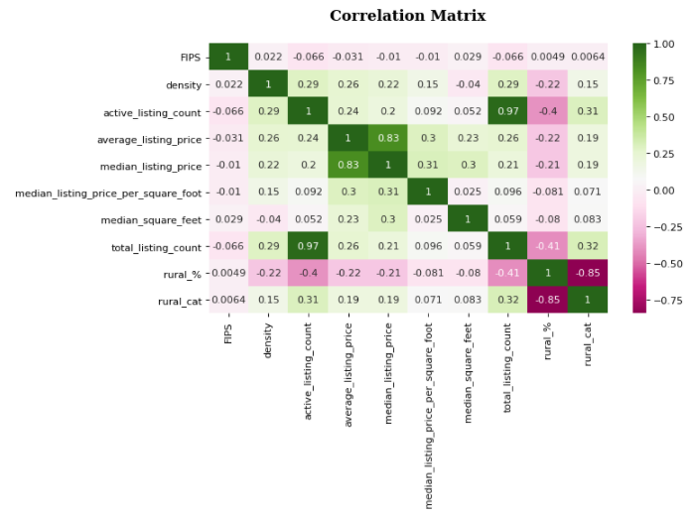
Initial Exploratory Results Correlational Matrix
In this matrix, the highest correlation is between active listing count and total listing count which is 97%. The second highest is between average listing price and median listing price which is 83%.

Slide 8
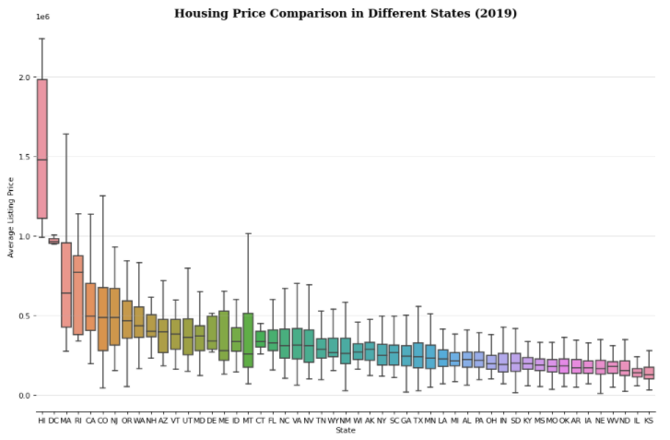
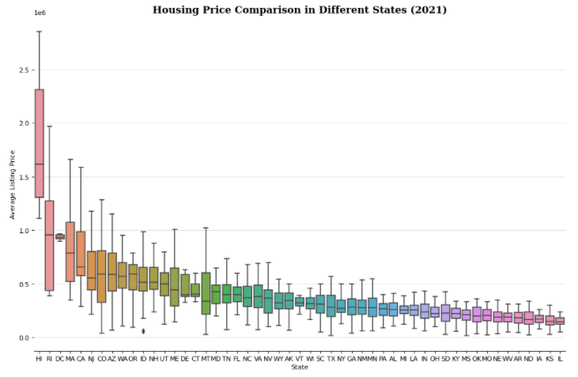
Initial Exploratory Results Average Listing Price
2019
2021

Slide 9
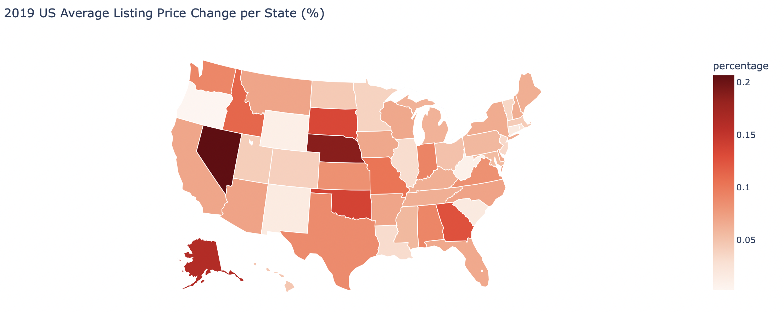
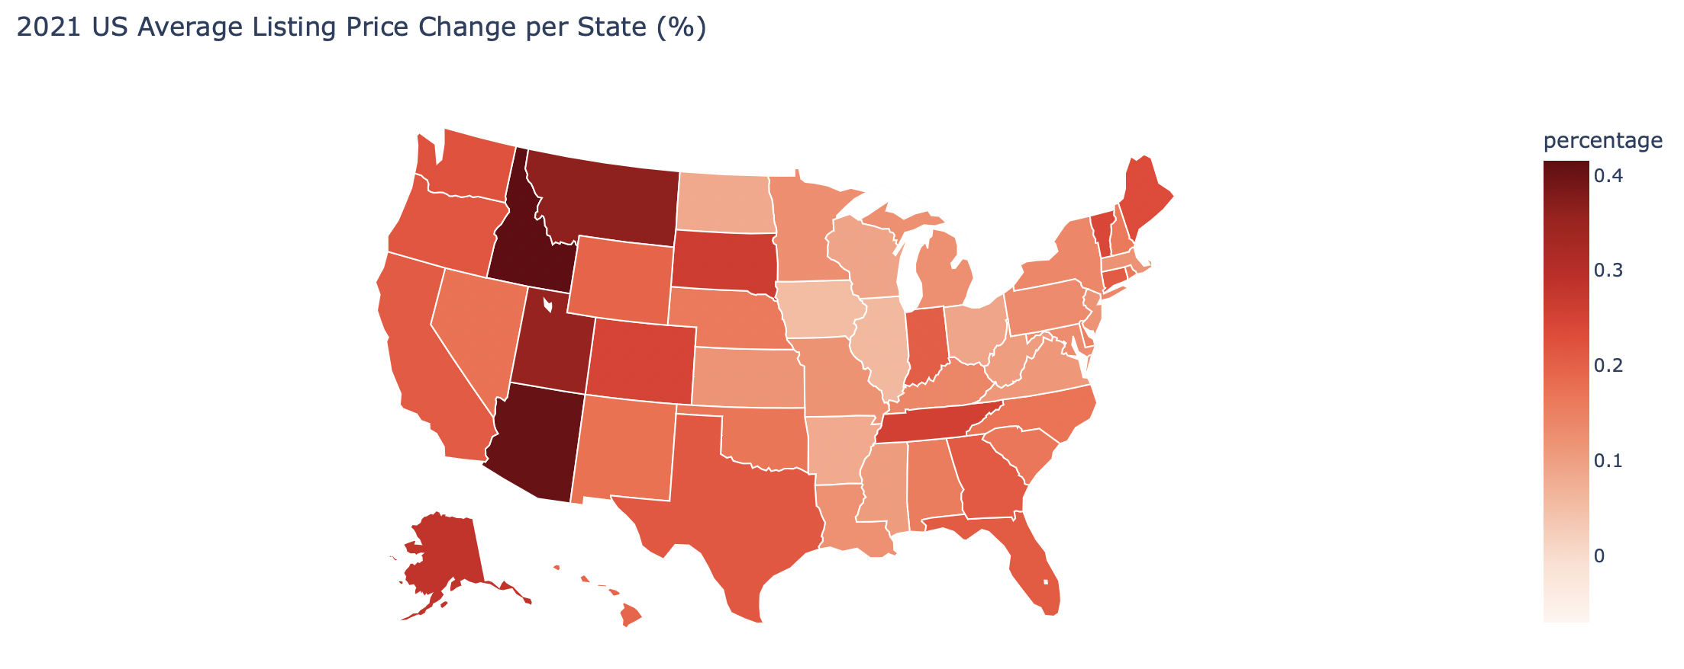
Initial Exploratory Results Average Listing Price Change (%)
2019
2021

Slide 10
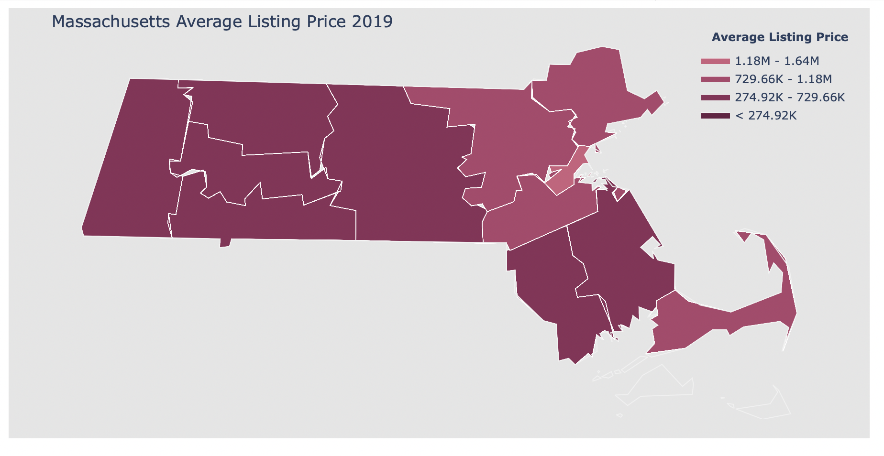
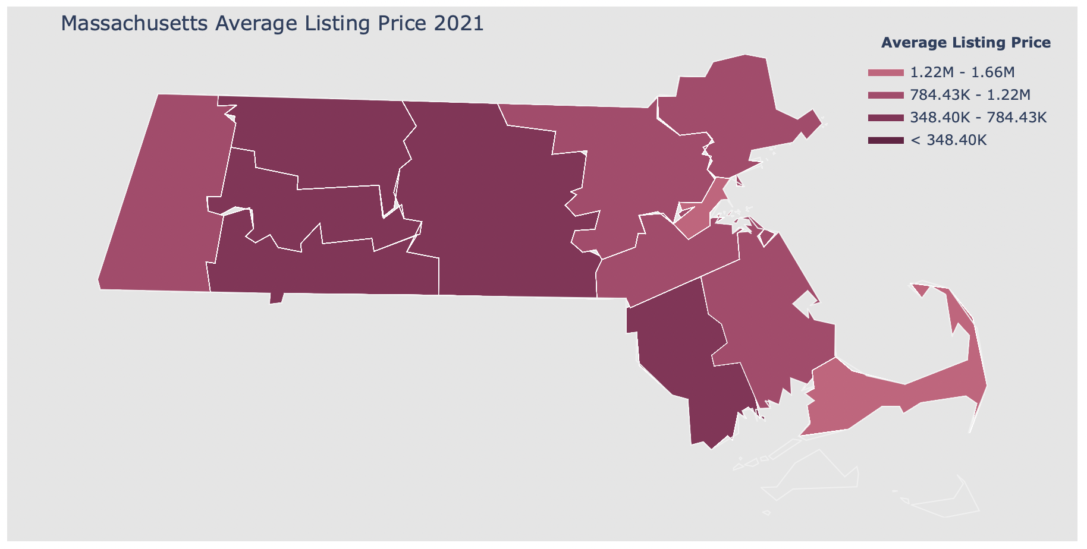
Initial Exploratory Results Average Listing Price
2019
2021

Slide 11
Machine Learning Model
The machine learning model to be used for this project is K-means with centroid. K-means works by selecting how many clusters, k, exist in the data. Each cluster will be represented by a centroid (average) of similar points with continuous features.
It will be applied to the average listing price, average listing price change, rural percentage, and density on the county, state, and individual state level.

Slide 12
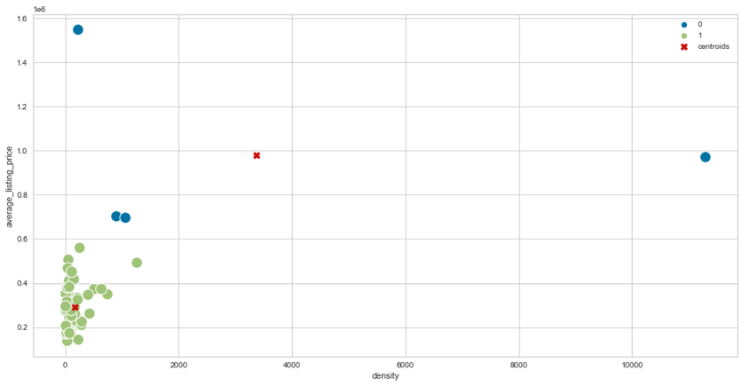
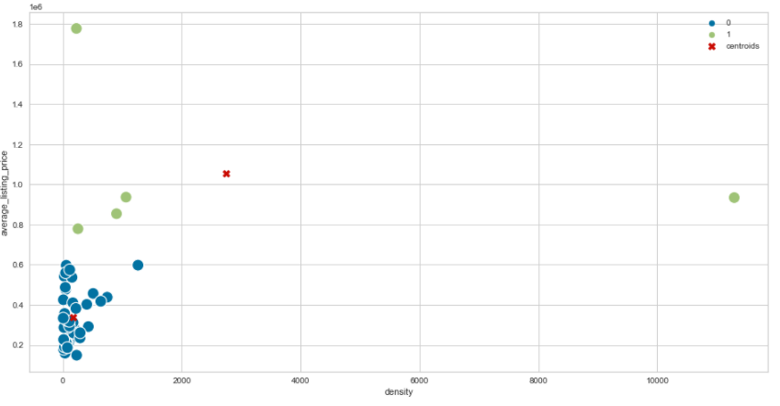
K-means Average Listing Price (State Level)
For 2019
For 2021

Slide 13
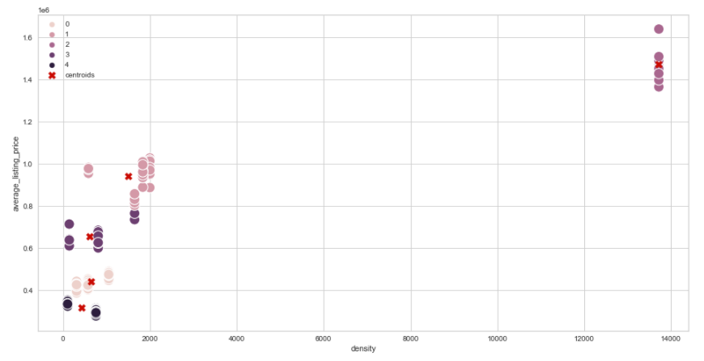
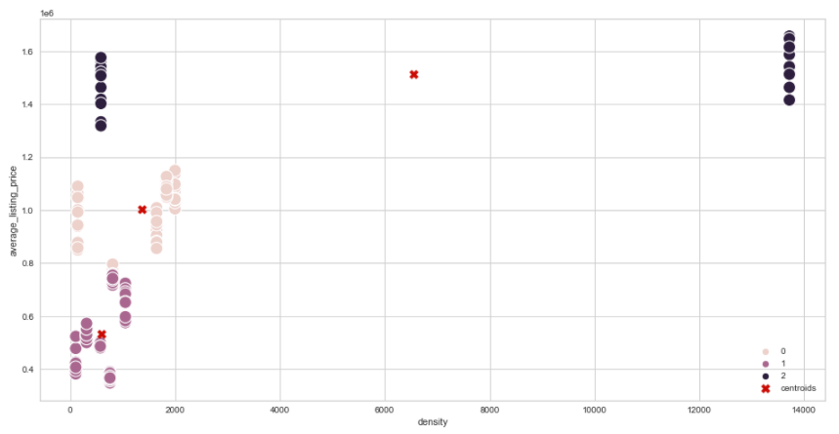
K-means Average Listing Price (Individual State Level)- Massachusetts
2019
2021

Slide 14
References
Friedman, N. (2022, February 23). Home-Price Growth Hit Record in 2021. Wall Street Journal - Online Edition, N.PAG.
Liu, S., & Su, Y. (2020). The Impact of the COVID-19 Pandemic on the Demand for Density: Evidence from the U.S. Housing Market. 47. Retrieved Feb. 3, 2022. https://yichensu.files.wordpress.com/2021/04/liusu_covid_4_11_21.pdf
Polzin, P. E. (2021). THE MYTH OF MONTANA’S HOUSING MARKET FRENZY: Has COVID-19 Related Migration Spurred the Recent Rise in Home Prices? Montana Business Quarterly, 59(2), 10–13.
Real Estate Economist Mark Dotzour Forecasts Post-COVID Suburban Migration on HomeVestors. (2020, July 10). Entertainment Close-up. https://link.gale.com/apps/doc/A629042656/BIC?u=umd_umbc&sid=bookmark-BIC&xid=fb84eb82
Zhai, W., & Peng, Z.-R. (2021). Featured Graphics: Where to Buy a House in the United States amid COVID-19? Environment and Planning A, 53(1), 9–11. Retrieved Feb. 3, 2022. https://doi-org.proxy-bc.researchport.umd.edu/http://epn.sagepub.com/content/by/year

